Slide 1


Hands on Workshop

Slide 2
1
SERIAL COMMUNICATION

Slide 3
SERIAL COMMUNICATION
A type of sharing information.
Data can be
A string, A character, A number
ASCII – A standard to represent any character in decimal format.
Bits – 0’s and 1’s
Eg:
String – “ACROM Welcomes You ”
Character – “A”. //a-z, symbols
Number – “1” //0-9
DATA
ASCII
BITS

Slide 4
SERIAL COMMUNICATION
Start bit: To intimate the receiver that the data has arrived.
‘0’
Data field: Actual data in bits
5-8 Bits
Parity field – Error Checking
Stop bit: To end the transmission
2 bits ‘11’.
Start Bit 1 bit | DATA 5-8 bits | Parity 1 bit | Stop bits 2 bits
Eg: To send a character ‘A’
DATA | A
ASCII | 65
A Binary Form | 0100 0001
0 | 01000001 | 0 | 11

Slide 5
SERIAL COMMUNICATION
Baud Rate: No of bits transmitted per second
9600, 38400,4800
Baud rate decides the speed of transmission
Transmitter and receiver both should have the same baud rate.

Slide 6
SERIAL INTERFACING
char x;
void setup()
{
pinMode(13,OUTPUT)
Serial.begin(9600);
}
void loop()
{
if (Serial.available()!=0)
{
x = Serial.read();
Serial.println(x); //to display on the serial monitor
if (x == ‘1’)
digitalWrite(13,on);
else if (x == ‘0’)
digitalWrite(13,off);
}
}
Serial.begin()
Serial.read()
Serial.write()
Serial.available()
Serial.println()

Slide 7
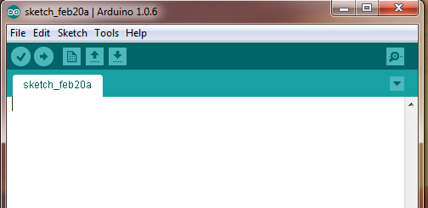
Notes:
1. Need of serial communication
2. Serial monitor
3. Demonstrate in software

Slide 8
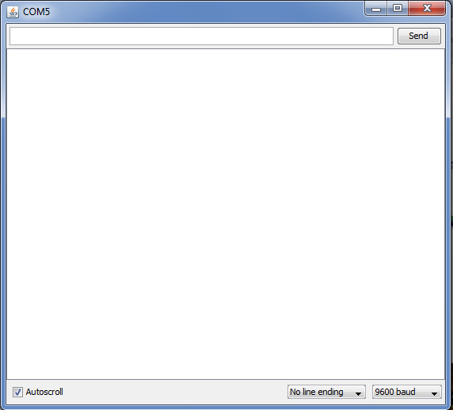
( Add Pic of serial monitor)

Slide 9
2
Obstacle avoider

Slide 10
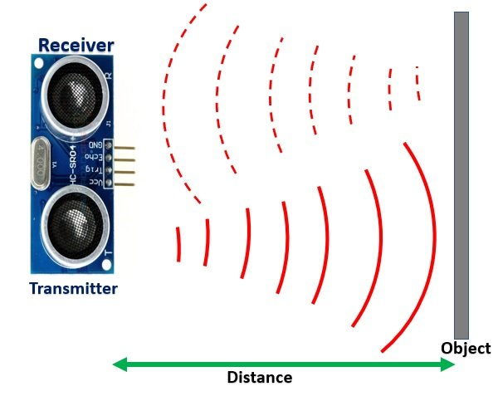
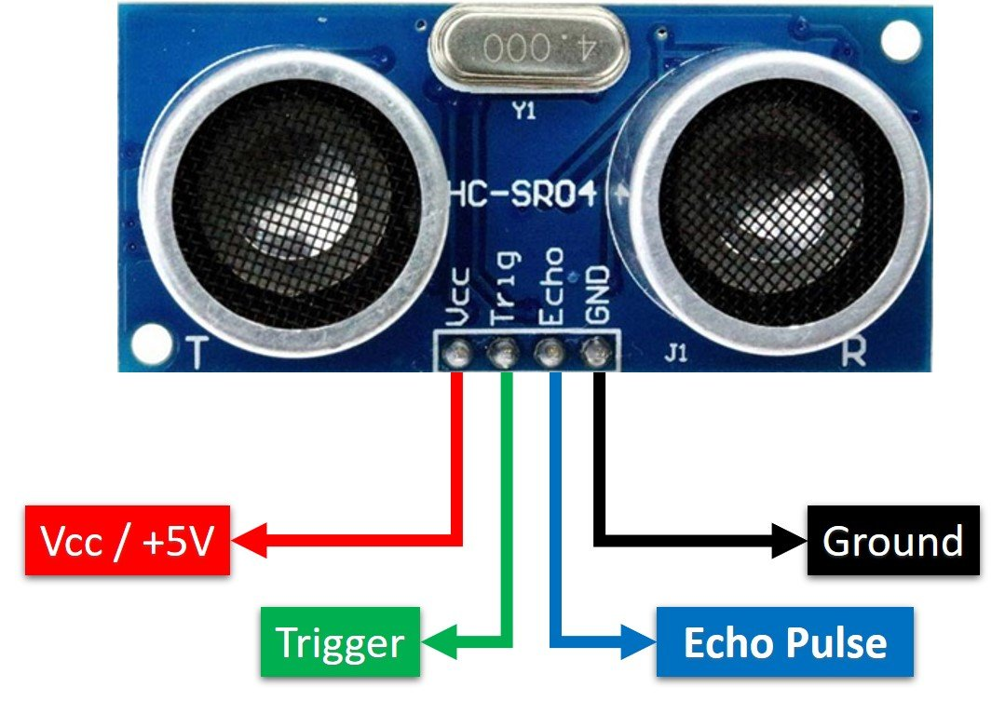
Ultrasonic sensor

Slide 11
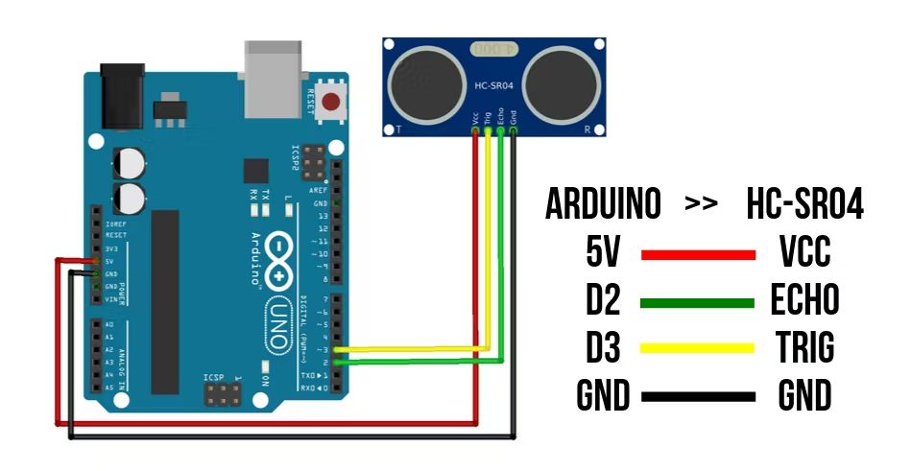
Connection with arduino

Slide 12
logic
if ((distance > 20))
{
……
}
else if (distance < 18)
{
……….
}

Slide 13
2
Bluetooth controlled Robot

Slide 14
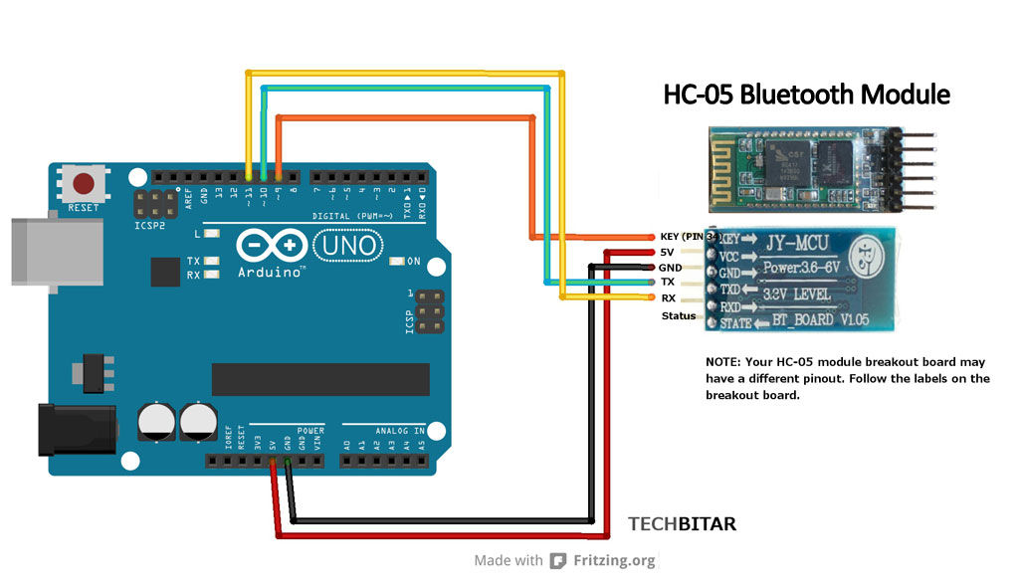
BLUETOOTH – HC05
Two Modes:-
Communication Mode
Configuration Mode

Slide 15
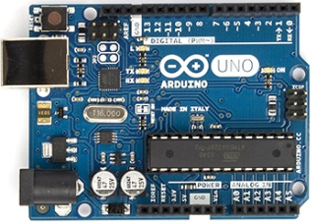
(3)(5) (10)(11)
IN1
IN2
GND
VCC
H-Bridge
(Motor Driver)

Slide 16

Bluetooth RC car - Android Application

Slide 17
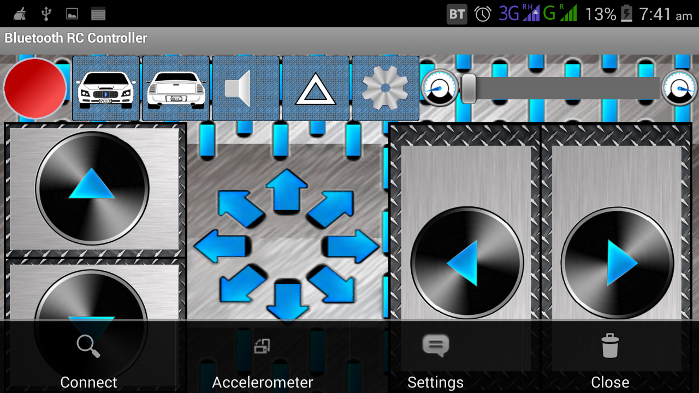

Slide 18
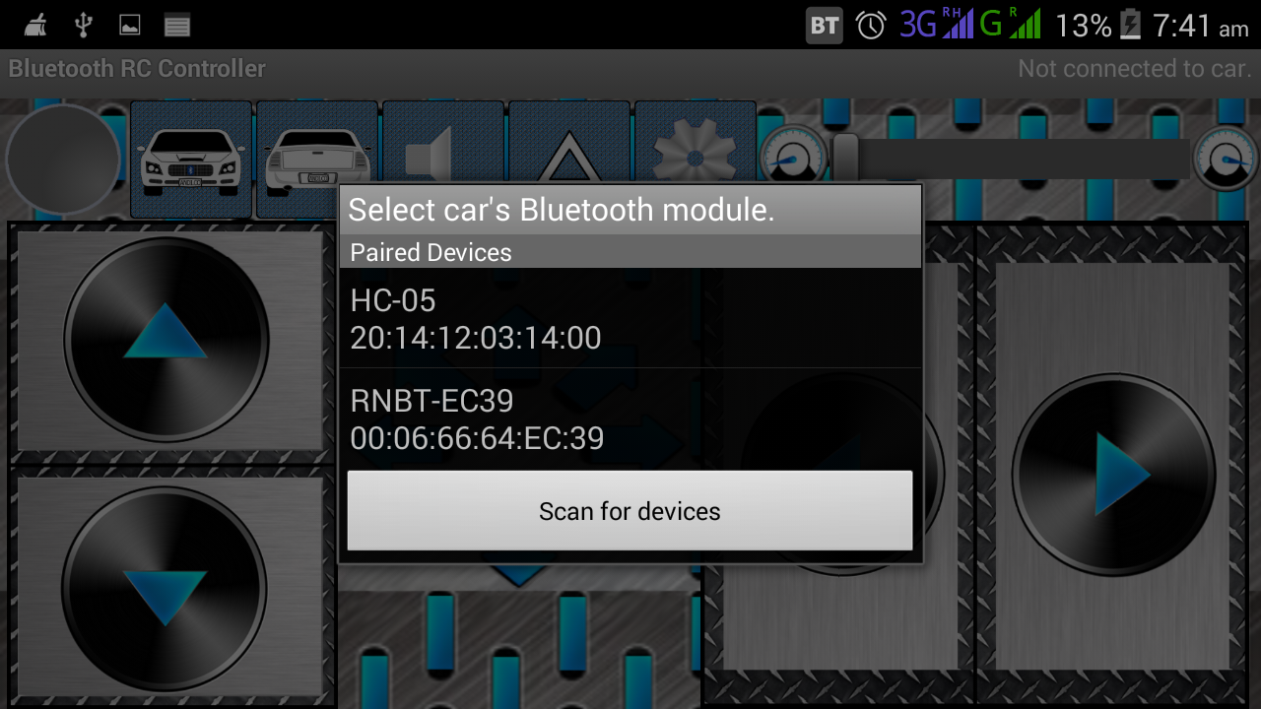

Slide 20
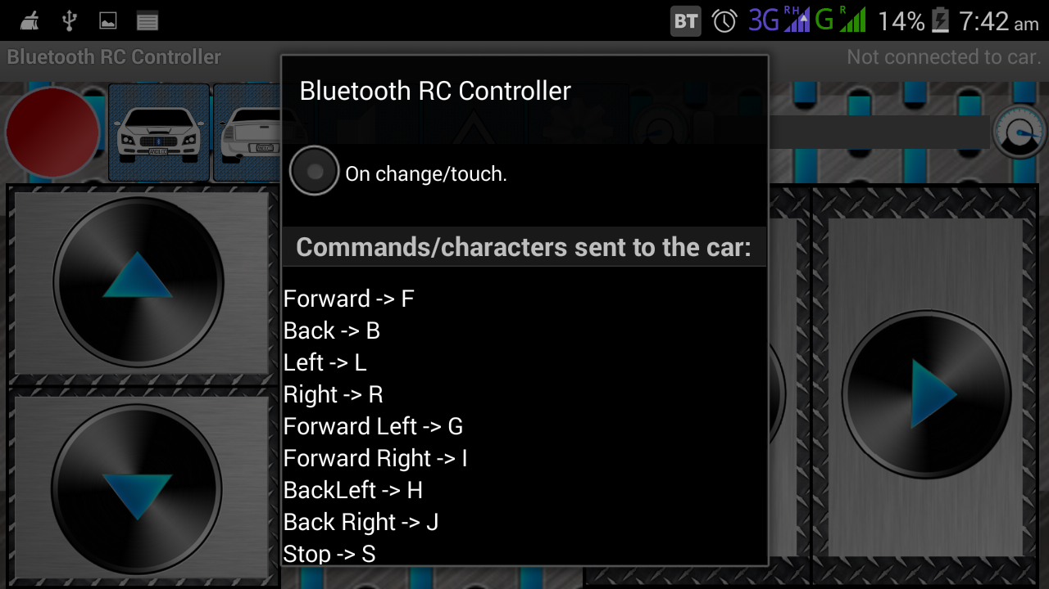

Slide 21
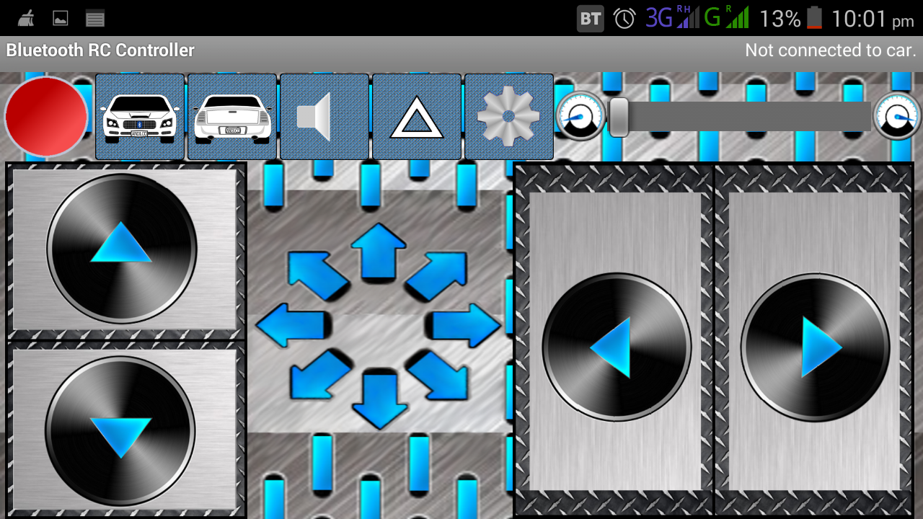

Slide 22
char x;
void setup()
{
Serial.begin(9600);
}
void loop()
{ while(Serial.available()==0);
x = Serial.read();
Serial.println(x);
}

Slide 23
4
Sumo wrestler

Slide 24
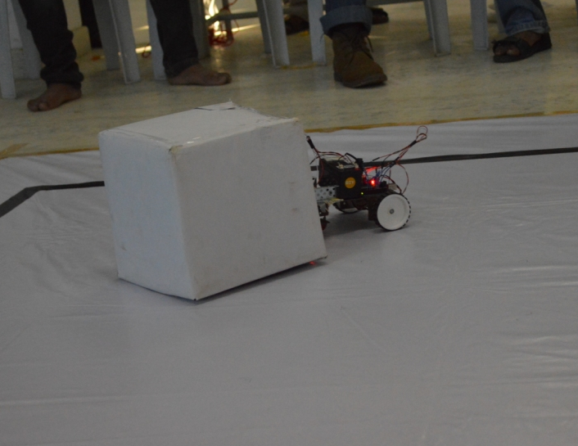
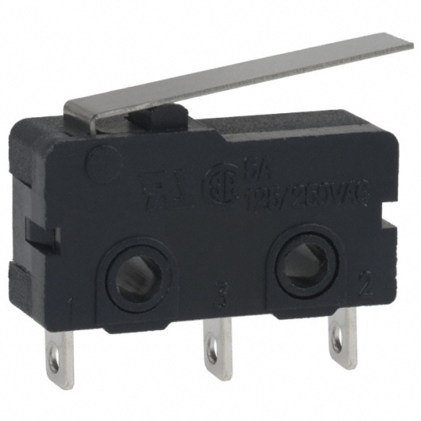
SUMO WRESTLER
Sense the Object or the robot
Sensor – Switch
COM
NC
NO

Slide 25
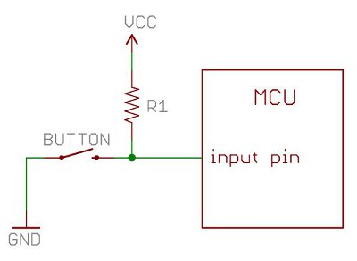
Arduino
input pin
5v/0v

Slide 26
// declarations of pins
int sen1=6;
int state1;
void setup()
{
// initialize the digital pins as an input.
pinMode(sen1, INPUT_PULLUP);
}
void loop()
{
state1 = digitalRead(sen1);
}
State | Action
HIGH(5v) | Not pressed
LOW(0v) | Pressed

Slide 27
Any Questions

Slide 28
Thank You!

